Slide 1
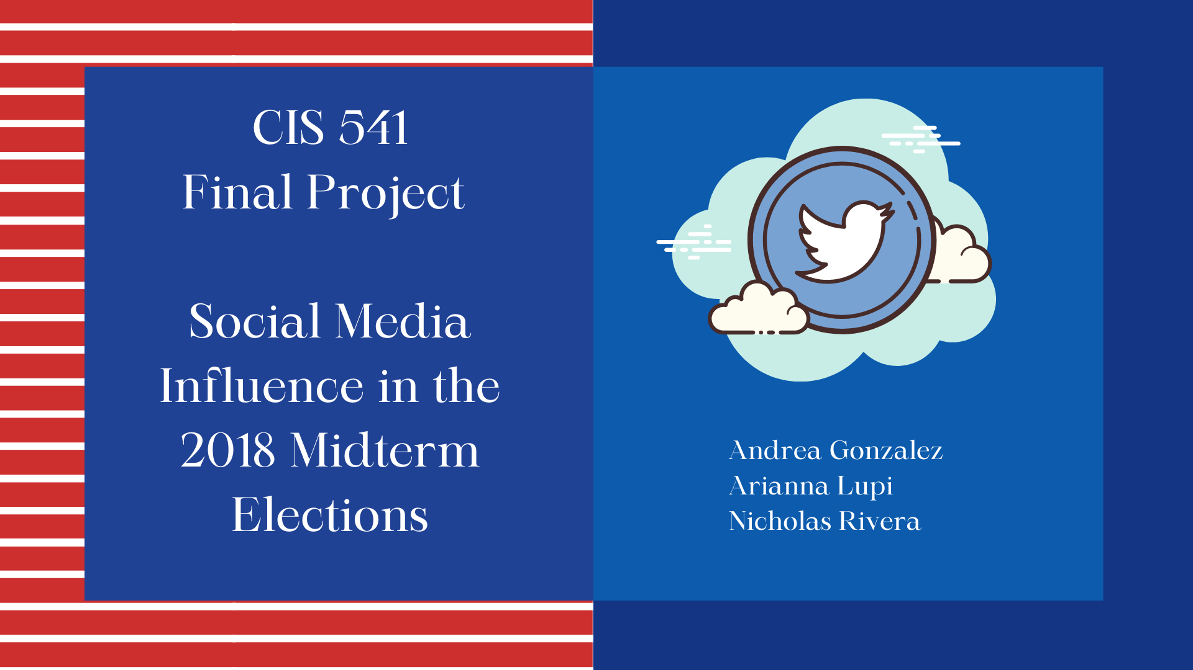

Slide 2
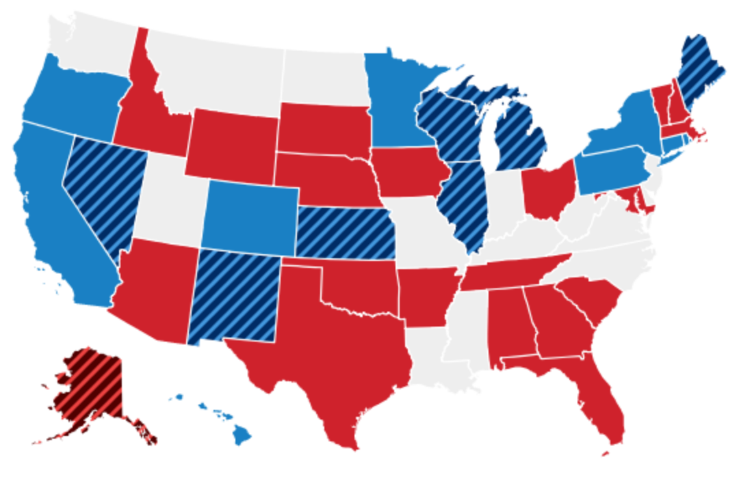
Problem Statement
Does Social Media influence Political Bias?

Slide 3

PURPOSE
MOTIVATION
-Enforce more control over fake news and misinformation on social networks
-Motivate developers to create responsible algorithms to detect fake information and bots
- Understand if there’s biases on voters that utilize social media.
-Discover the possible impact of fake news and targeted political advertising on voting patterns

Slide 4
Data
We are taking data from the following Data Frames:
Political Tweets 124 MB
Open Elections Dataset 28GB
We are going to look at data from 2018 Midterm Elections and 2018 Political tweets (Midterm Elections) in the State of Florida see if there’s a positive correlation and a significant relationship.
Total Data = 28.1GB
Used Data = 332 MB

Slide 5
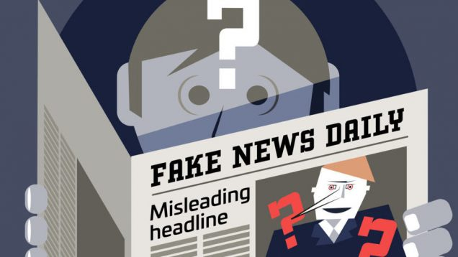
Hypothesis Analysis
Null Hypothesis:
Social Media does not affect political biases
Alternative Hypothesis:
Social Media does affect political biases

Slide 6
Variables
Data Frames:
Political Tweets: political hashtags from 2018 midterm election campaigns
Midterm Elections votes
and candidates
Dependent Variable:
Political Bias
Independent Variable:
Hashtags from 2018 Midterm Elections

Slide 7
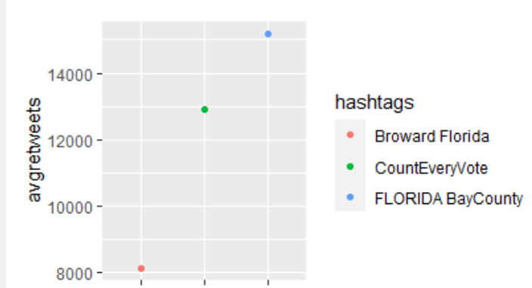
Political Tweets:
We filtered by Hashtags and retweets to determine which tweets were more popular…
Also, we assigned a binary variable to tweets that were in favor or Democrats or in favor of Republicans.
We did this with the function str_detect
Data set that consists of Midterm Elections related Political Tweets from either neutral, Republican, Democrat or Independent inclined users

Slide 8
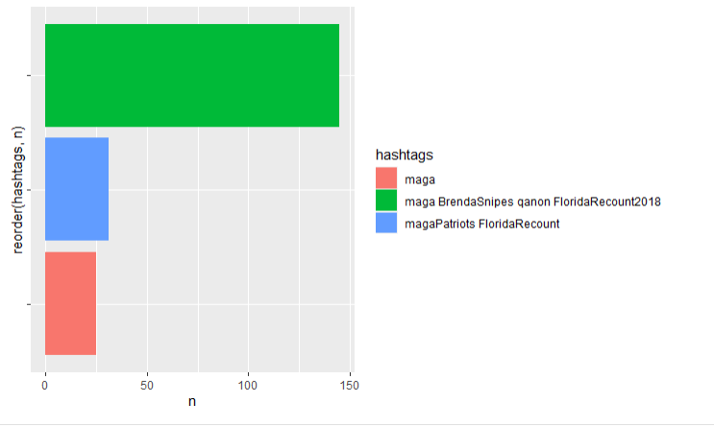
Variables
Republican Retweeted Hashtags
ent Variable:
Hashtags from 2018 Midterm Elections
We were able to determine the retweeted hashtags for each party. We did this with a filter and str operator to select the keywords related to republicans:
"maga|republican|trump|desantis| De Santis| GOP | gop | FOX|potus"
And we also exclude the following words that are negatively associated with that party.
“corrupt | liar | impeach | fuck | stop | tyrant | dictator|fucktrump | nazi”

Slide 9
Variables
Democrat Retweeted Hashtags
ent Variable:
Hashtags from 2018 Midterm Elections
We were able to determine the retweeted hashtags for each party. We did this with a filter and str operator to select the keywords related to democrats:
"democrat | liberal | dem | BlueWave | hilary | CNN | obama | OBAMA "
And exclude the following words that are negatively associated with that party.
" fake | corrupt | socialists | CrookedHillary | emails"

Slide 10
Variables
Republican Retweeted Hashtags
ent Variable:
Hashtags from 2018 Midterm Elections
Democrat Retweeted Hashtags
8 Midterm Elections
Democrat Hashtag Retweets:
1,006
Negative Democrat Hashtag Retweets:
4
Republican Hashtag Retweets:
801
Negative Republican Hashtag Retweets:
20
Total Retweets Per Hashtag:
30,670
Total Retweets Considered ”Neutral”
28, 839

Slide 11
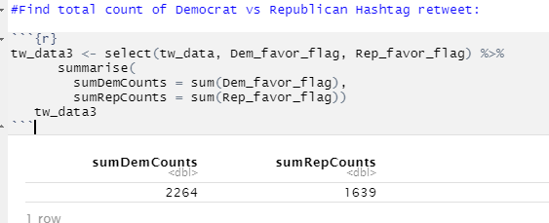
We created a Flag for each count of Democrat vs Republican Tweets

Slide 12
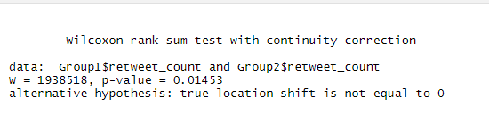
Hypothesis Testing: Are the retweet counts for the Democrat Party hashtags significantly different than the retweet counts for the Republican Party hashtags?
Our independent variable:
Retweets of a hashtag
Our dependent variables:
Republican Hashtag Retweets
Democrat Hashtag Retweets
Results:
P value is smaller than alpha, we reject the null hypothesis.
We support the claim that there is a significant difference between the retweet counts for the Democrat Hashtags and the Republican Hashtags.

Slide 13
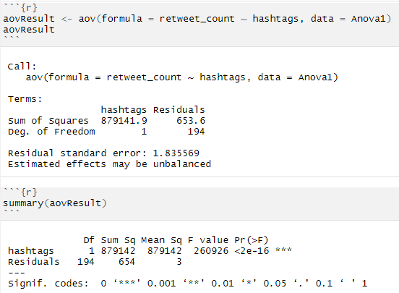
Variance: the population means for the Republican, Democrat, and Neutral hashtag tweets are equal.
H0: m1 = m2 = m3 (claim)
H1: m1 ≠ m2 ≠ m3
P-Value low we reject the null hypothesis that at all the means are equal.
We conclude that at least one of the population means is different

Slide 14
Models and Methods

Slide 15
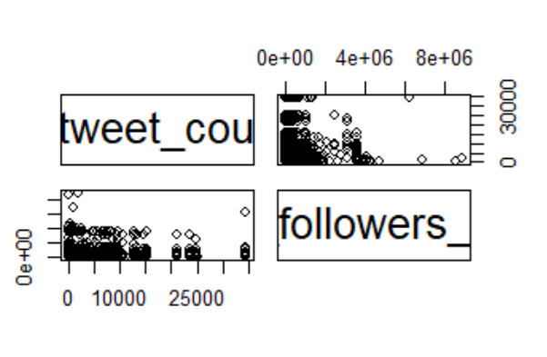
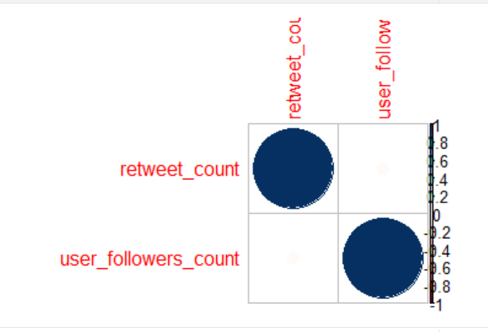
Correlation
Correlation between Retweet Count and Followers Count
-0.02470969 : Weak Negative Correlation

Slide 16
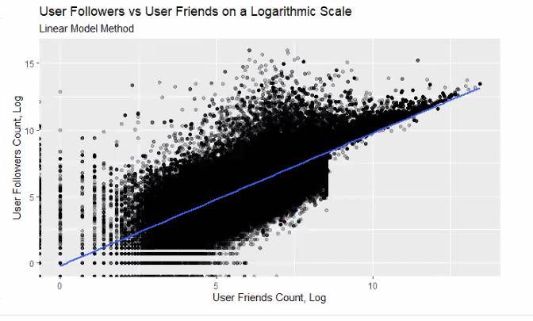
Variables
Linear Regression
or Univariate Model
ent Variable:
Hashtags from 2018 Midterm Elections
How?
We did a linear regression by comparing the user followers and user friends.
Results
We realized the linear model is not significant because the p value and R squared. Also, our prediction is outside of our model range.
Another way to confirm our result is by 0 resulting within a 95% of confidence interval.
Notes:
Nick

Slide 17
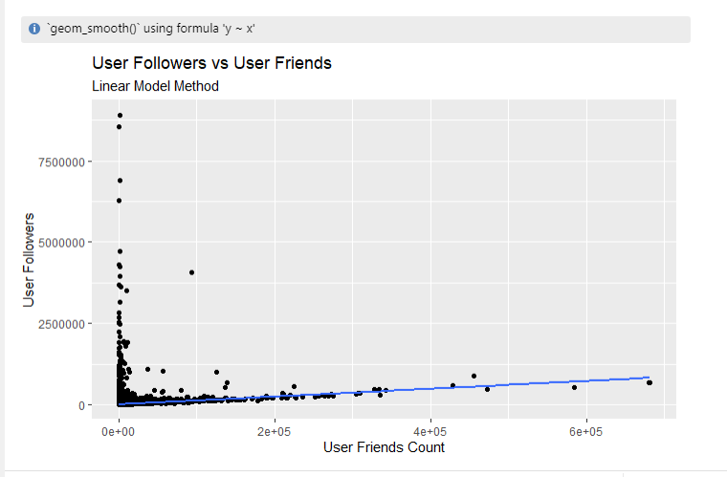
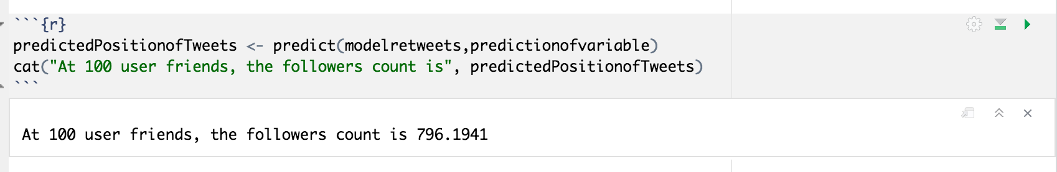
Variables
Linear Regression
ent Variable:
Hashtags from 2018 Midterm Elections
Prediction:
What would be the user followers when the user friends are 100?
Using predict ():
At 100 user friends, the followers count is 796.1941
Notes:
Nick

Slide 18
Non-Linear Regression (Loess Method)
ent Variable:
Hashtags from 2018 Midterm Elections
How?
We did a non-linear regression by comparing the user followers and user friends.
Results

Slide 19
Variables
Time Series
ent Variable:
Hashtags from 2018 Midterm Elections
Out Data Set “Twitter Political Data” was not eligible for Time Series Model since it does not have an ordered sequence of equally spaced time.

Slide 20
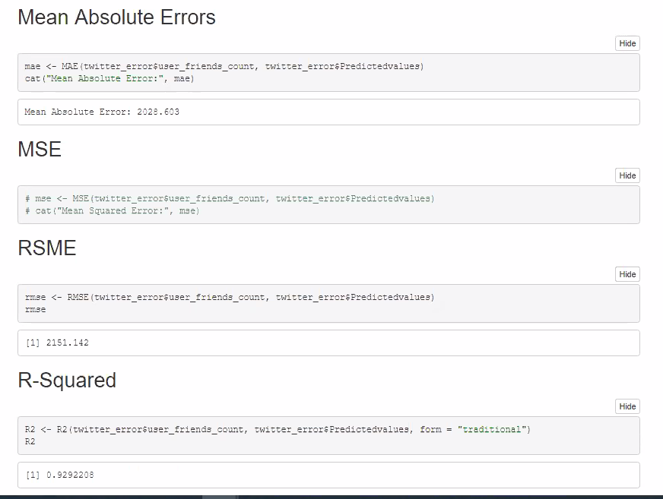
Variables
Errors
ent Variable:
Hashtags from 2018 Midterm Elections

Slide 21
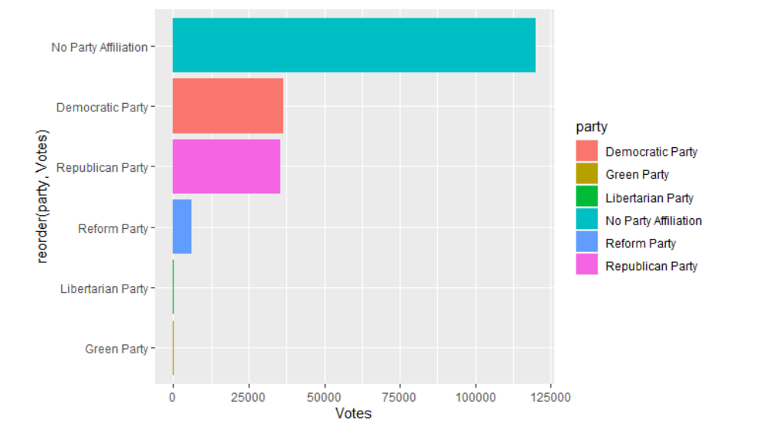
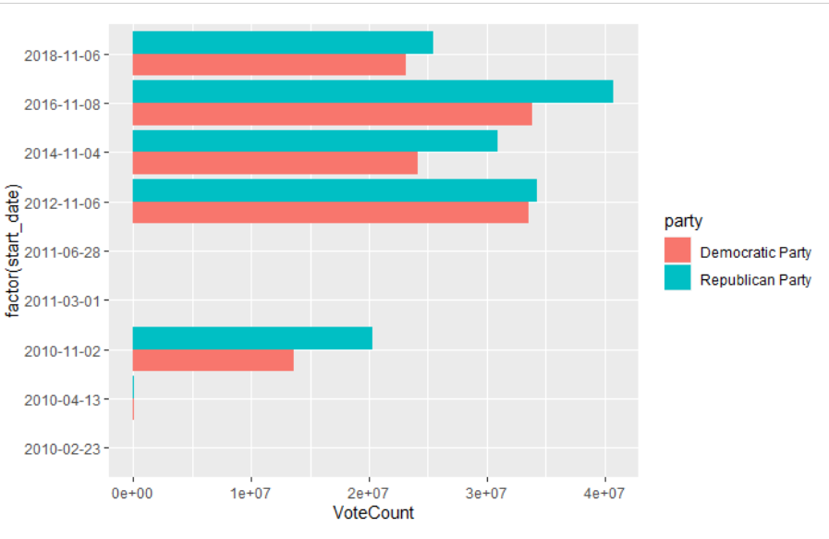
Florida Midterm Elections Data
We tidied the data and replaced variables to be able to combine different subfolders.
Also, we grouped the data by year, and party in order to map out the most voted parties.
Data set that consists of vote counts per candidate for the 2018 midterm elections and 2016 general elections

Slide 22
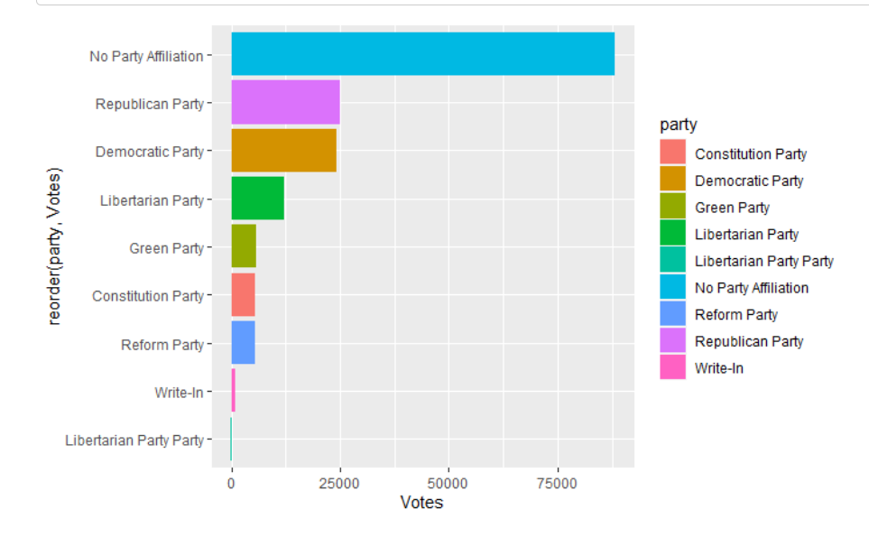
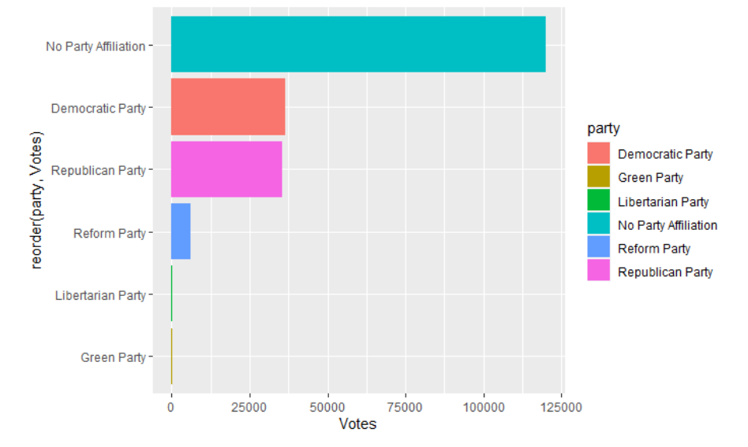
2016 vs 2018 Votes Per Party

Slide 23
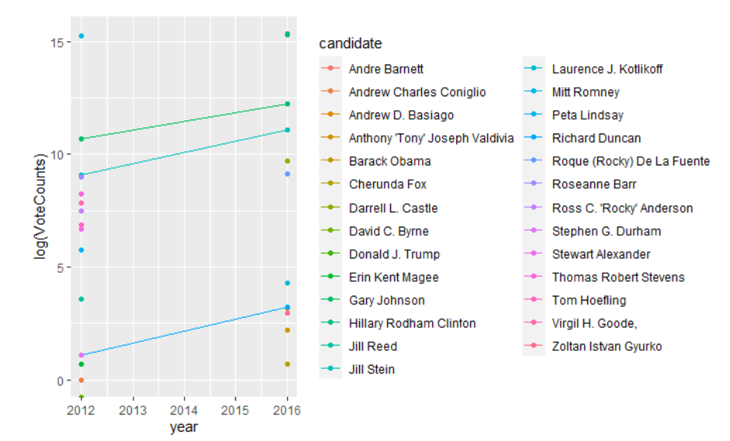
Candidates that ran in 2012 and 2016

Slide 24
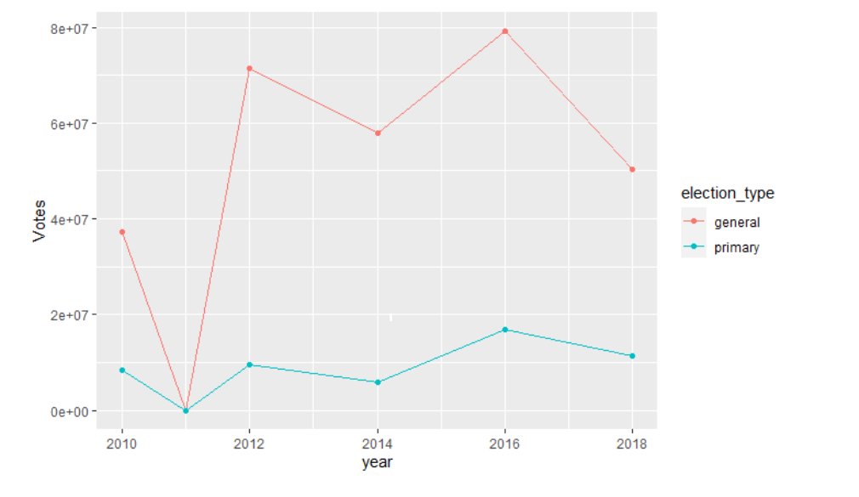
Votes in the Midterm elections 2018 vs General Elections in 2016

Slide 25
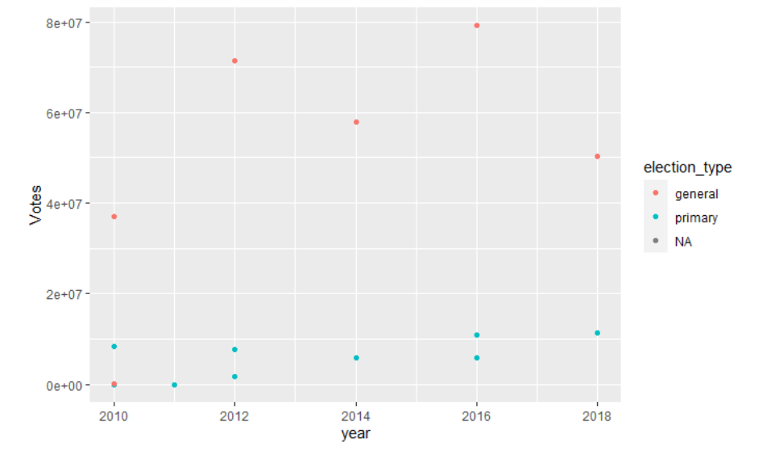
Votes per Year in General and Primary Elections

Slide 26
Comparing Political Hashtags to Midterm Election Votes:
In 2018 during the midterm elections, there were 50,861,970 votes for Republicans and 60,572,245 votes for Democrats. And 1,970,000 for other parties.
In total 113,412,989 votes
In 2018 within our twitter API data set, there were 801 hashtag retweets for Republicans and 1,006 hashtag retweets for Democrats
In total 900,270 hashtag retweets

Slide 27
Conclusion:
Votes:
54% Democrat
46% Republican
Tweets:
56 % Democrat
44% Republican
Even though we found no ways to correlate both data frames. We do find a similarity within the number of support each party was getting via Twitter during the 2018 Midterm Elections Period and the actual Result of the election.
Our future steps will be to relate both data frames with each other and find significant relationships within them.

Slide 28
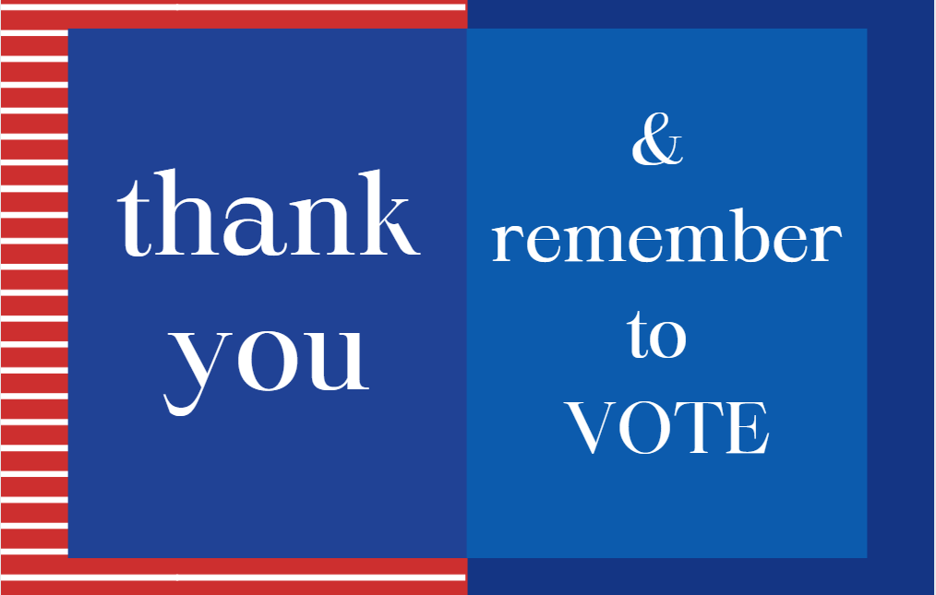

Slide 29

Q & A
Session
?
?
?
?
?
?
?

